Slide 1
MICROBIAL BIOTECHNOLOGY
PRINCIPLES OF MICROBIAL BIOTECHNOLOGY

Slide 2
PRINCIPLES OF MICROBIAL BIOTECHNOLOGY
Microorganisms – Most versatile and adaptable forms of life on earth.
Use of them for large scale industrial purposes has a long history.
With the development of science and knowledge about the genetics, biochemistry and physiology of MO’s, their applications in various fields is explored.
Various techniques of gene manipulation, rDNA technology, bioinformatics and Biocomputing – powerful tools for genomic and proteomic research.
The umbrella of MB covers many scientific activities ranging from production of recombinant human hormones to that of Microbial insecticides from mineral leaching to bioremediation of toxic wastes etc.
We shall discuss in brief about understanding of the various applications of MO’s, production of their bioactive molecules etc.

Slide 3
Applications
Microbial biotechnology, enabled by genome studies, will lead to breakthroughs such as improved vaccines and better disease-diagnostic tools, improved microbial agents for biological control of plant and animal pests, modifications of plant and animal pathogens for reduced virulence, development of new industrial catalysts and fermentation organisms, and development of new microbial agents for bioremediation of soil and water contaminated by agricultural runoff.
Microbial genomics and microbial biotechnology research is critical for advances in food safety, food security, biotechnology, value-added products, human nutrition and functional foods, plant and animal protection, and furthering fundamental research in the agricultural sciences.
The most advantageous microbial products not only are restricted to useful proteins and enzymes, antibiotics, antitumor agents, immunosuppressants but also include antivirals, anthelmintics, nutraceuticals, polymers, enzyme inhibitors, surfactants, bioherbicides, biopesticides, and many more agricultural and industrial products.

Slide 4
Applications:
Human Therapeutics
DNA vaccines
Secondary Metabolites as a source of Drugs
Agriculture
Food technology
Environmental applications of Microorganisms

Slide 5
Human Therapeutics:
Production of Heterologous Proteins:
Production of large number of proteins encoded by human genes in bacteria through genetic engineering.
Heterologous expression refers to the expression of a gene or part of a gene in a host organism, which does not naturally have this gene or gene fragment. ... Genes are subjected to heterologous expression often to study specific protein interactions. E. coli, yeast (S. cerevisiae, P.pastoris)
Insulin – first GE therapeutic agent to be approved for clinical trials in humans
Human Growth Hormone – produced in E.coli.
Human tissue Plasminogen activator – proteolytic enzyme with an affinity for fibrin clots.
A number of recombinant human gene products are produced in bacteria and fungi – Interferons, Interleukins, Factor VIII, Factor IX etc.

Slide 6
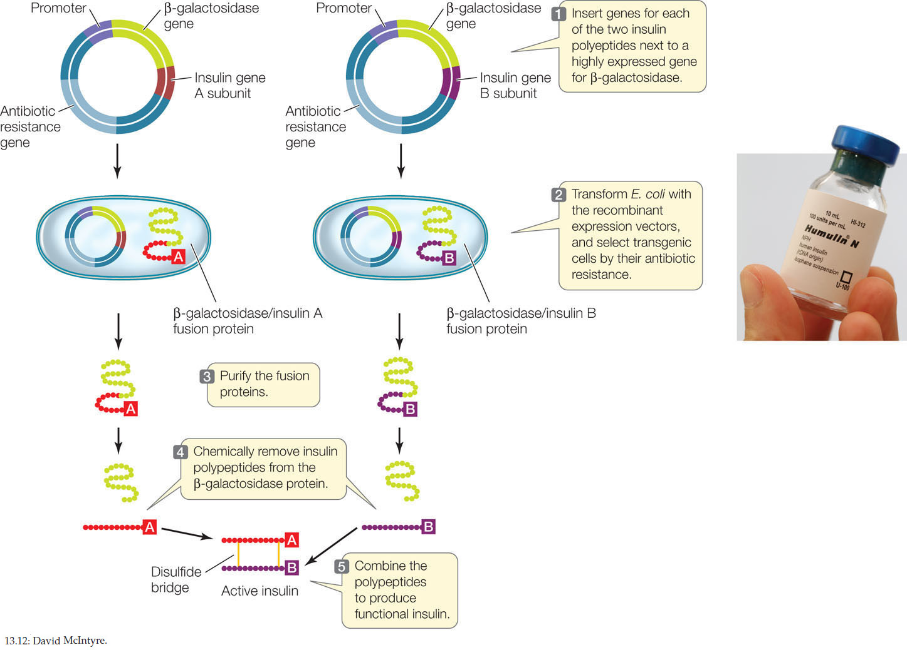

Slide 7
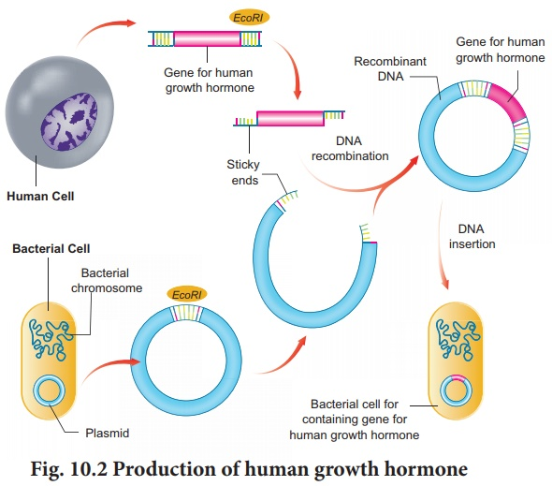

Slide 8
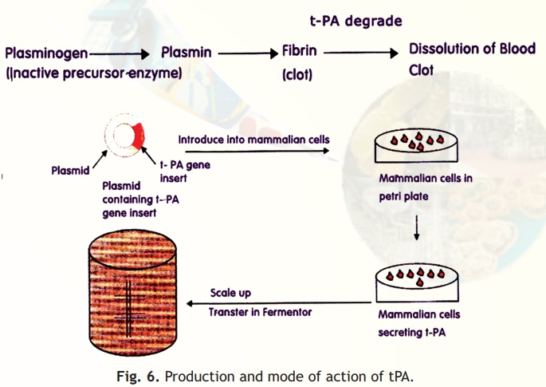

Slide 9
DNA vaccines:
Consist of appropriately engineered plasmid DNA prepared on a large scale in E.coli.
Vaccine plasmid – includes strong promoter system for expression in eukaryotic cells of an antigen protein ( cytomegalovirus), a cloning site for the insertion of the genes encoding the antigenic protein and an appropriately located Poly A tail, that is important for translation efficiency and stability of the mRNA
Plasmid also contains Prokaryotic OOR and a selectable marker, ampicillin resistance gene.
Generally introduced by intramuscular injection
DNA vaccines induce both humoral and cellular response
In clinical trails, vaccines for malaria, hepatitis B, HIV, influenza elicited only moderate response in human volunteers
More research needed.

Slide 10
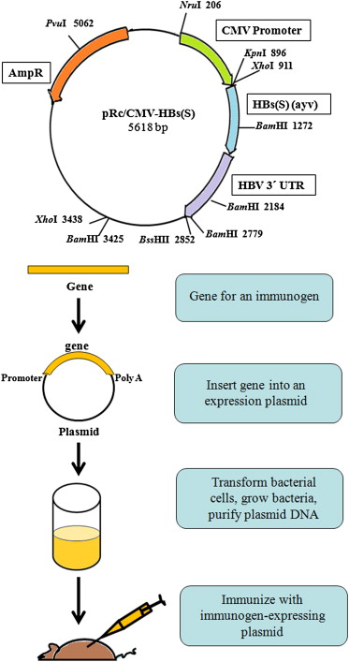

Slide 11
Secondary Metabolites as a source of Drugs
Mo’s produce huge number of small MW compounds – SM
Many compounds have been screened and found invaluable as antibacterial, antifungal anticancer and immunosuppressant's etc.
Mo’s have been genetically modified to produce such compounds in large amounts – antibiotics – most important for human therapeutics.
AVERMECTINS:
Discovered in 1980’s as a result of a deliberate search for anthelminthic compounds produced by soil microorganisms.
Streptomyces avermitilis – producer of avermectins – produces a family of closely related macrocyclic lactones, compounds active against certain nematodes and arthropods at extremely low does, but have relatively low toxicity to mammals.
Act on invertebrates by activating glutamate- gated chloride channels in their nerves and muscles, disrupting pharyngeal function and locomotion – paralyzed parasite most likely starves to death.
Selective toxicity – they do not harm vertebrates – as they affect specific cellular targets either absent or inaccessible in the resistant organism or host.

Slide 12
Zaragozic acids (Squalestatins)
Over 93% of cholesterol in human body is located in cells, 7% circulates in the plasma.
For delivery to tissues, plasma cholesterol is packaged in lipoprotein particles, two thirds is associated with LDL and rest as HDL.
Hypercholesterolemia – elevated plasma levels of cholesterol bearing LDL – leads of heart attacks.
Cholesterol – product of the Isoprenoid pathway in mammals which also produces steroids and other key metabolic intermediates essential to cells.
Screening of fungal cultures led to the discovery of three structurally related and very potent inhibitors of Squalene synthase.
Zaragozic acid A – water sample from the Jalon river in Zaragoza, Spain – hence the name

Slide 13
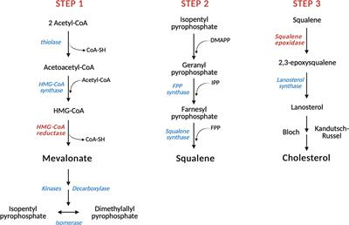
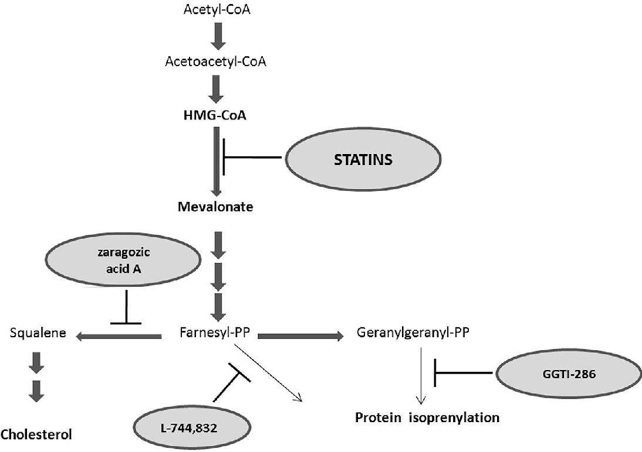

Slide 14
Zaragozic acids (Squalestatins)
Zaragozic acids B & C were obtained from fungi isolated elsewhere: Sporomiella intermedia and Leptodontium elatins.
Squalene synthase catalyzes a two step reaction FPP to PSqPP to Squalene.
Zaragozic acids – potent inhibitors of squalene synthase competitive with farnesyl pyrophosphate.
Other therapeutic applications – shown to cure prion infected neurons and to protect against prion neurotoxicity.
Prion diseases are fatal neurodegenerative disorders that include Kuru and Creutzfeldt – Jakob disase in humans.
In prion diseases, the normal cellular prion, PrP^{c} is converted into a B sheet rich conformer, PrP^{sc} whose aggregation is believed to lead to neurodegeneration.
Low concentration of squalestatins reduced the cholesterol content of the neurons and prevented the formation of PrP^{sc} - Potential drug for prion diseases.

Slide 15
Taxol
Anticancer drug – Diterpenoid with multiple asymmetric centers was isolated in 1965 from the Pacific yew bark (Taxus brevifolia) – blocks the cell cycle in its G1 or M phase by stabilizing the microtubule cytoskeleton. It prevents the depolymerizatioin of microtubules during cell division.
Slow growing tress – threatened with extinction.
In 1989 commercially viable organic synthesis of taxol.
In early 2000’s, a plant cell fermentation process – calluses of specific Taxus cell line was propagated on a simple defined medium to produce taxol.
Possibility – explored – taxol producing endophyte in Taxus sps.
1993 – Taxol producing endophytic fungus, Taxomyces andreanae, was discovered in T.brevifolia.
Subsequently, many fungal endophytes in a wide variety of higher plants were found to make taxol.
Further research being carried out to increase the production levels.
Paclitaxel – chemotherapy medication used to treat ovarian, breast, lung, cervical and pancreatic cancers.

Slide 16
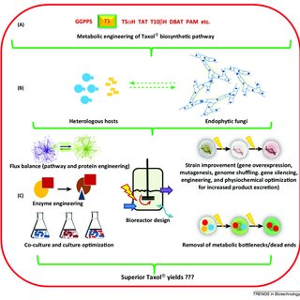
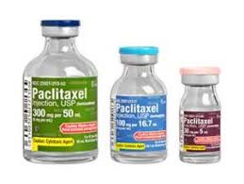

Slide 17
Agriculture
Creation of Transgenic plants.
Generated by exploiting a plasmid vector carried by Agrobacterium tumefaciens (crown gall disease in over 140 sps. Gram negative).
Foreign DNA carrying 1-50 genes can be introduced into plants.
Higher plants have genes whose expression shows precise temporal and spatial regulation in various parts of the plants.
Other plant genes respond to different stimuli, such as plant hormomes, nutrients, heat shock etc.
Insertion of control sequences into transgenic plants confine the expression of foreign genes to specific organelles or tissues.

Slide 18
Ability to grow in Harsh environments
Habitat range can be extended by imparting triats such as cold, heat, drought tolerance, high moisture or high salt concentration etc.
Tolerances towards environmental stresses – another challenge
Trehalose – a disaccharide of glucose, acts as a compatible solute that stabilizes and protects proteins and biological membranes in bacterial, fungi and invertebrates from damage during dessication.
Most plants do not accumulate detectable amounts of trehalose
E.coli genes otsA and otsB for trehalose biosynthesis were introduced into rice.
UDPGIC + Glc 6-phosphate otsA trehalose 6-phosphate otsB trehalose (in bacterial and yeast)
The two enzymes are trehalose 6-phosphate synthase (otsA) and trehalose 6-phosphate phosphatase (otsB).

Slide 19
Ability to grow in Harsh environments
Higher plants contain genes homologous to otsA &otsB.
A fusion gene was generated – and to obtain tissue-specific or stress inducible expression, two different constructs were made
1. fusion gene – equipped with a transit peptide, was placed under the control of the promoter of rbcs, gene encoding the small subunit of ribulose biphosphate carboxylase, to direct the gene product to the chloroplast
2. gene was placed under the control of an abscisic acid – inducible promoter. Here the fusion enzyme remains in the cytosol.
Constructs were introduced into rice using Agrobacterium mediated gene transfer.
Compared to nontransgenic plants, the transgenic lines showed sustained plant growth under drought, salt or low temperature stress conditions.
Transgenic rice contained 3-9 fold greater levels of trehalose.
Detailed analysis showed – less photo oxidation damage to photosystem II, higher levels of soluble carbohydrate and greater ability to control K+/Na+ balance in the roots under stress conditions.
Results indicate that trehalose acts as a regulatory molecule that affects the expression of genes associated with carbon metabolism and those involved with ion uptake and possibly other processes as well.
Initial field trails are promising – prospect of growing rice under harsh conditions.

Slide 20
Resistance to insect pests:
Bacillus thuringiensis – produces protein endotoxins that permeabilize the epithelial cells in the gut of the larvae/ insects.
Transgenic plants have been created where the Bt toxic genes have been introduced into tobacco, tomato, cotton etc.
We shall discuss more about transgenic plants in another topic.
A different approach to achieve the same end was to transfer Bt endotoxin gene into bacteria such as Clavibacter xyli subsp. cynodontis which colonizes the interior of plants.
Can be introduced into corn – recombinant C.xyli strains showed promise in controlling leaf and stem feeding lepidopteran larvae.

Slide 21
Bacillus subtilis strains as broad spectrum microbial pesticides:
Secrete a formidable array of compounds which display antifungal, antibacterial and even insecticidal activities.
Produce classes of lipopeptides like iturins and plipastatins, surfactin, iron chelating agents and also a potent proteases with broad specificity.
Strains capable of producing these potent mixture of products can be obtained by SSF with soybean curd residue as substrate – cells produce elevated level s of these lipopeptides and the broth can directly be applied to soil, to suppress the growth of various plant pathogens.
Patented strain of B.S. Qst.713 produces more than 30 of these different lipopeptides and the strain is growth under SSF and the broth containing cells, spores and lipopeptides is concentrated and spray dried. The resulting powder is sold as biofungicide either in dry or aq.suspension.
When applied on plants – coats leaf surfaces, preventing the attachment of pathogens
Lipopeptides destroy fungal cells and spores by permeabilizing their membrane.

